Slide 1
COMP 7500 Advanced Operating Systems Project 1 – Installing CentOS
Dr. Xiao Qin
Auburn University http://www.eng.auburn.edu/~xqin
xqin@auburn.edu
Notes:
We install CentOS 6.5
CentOS 7 Aug. 2015
Version 7.3 Jan. 2017
Version 7.4 Jan. 2018

Slide 3
Please remember to return your CentOS CDs to Dr. Qin after you complete Project 1.

Slide 4
DevOps: development + operations
Notes:
Project 1: this is an IT project (operations).
Story: Docker Containers
http://devops.com/2014/11/24/docker-vs-vms/
Reference: https://en.wikipedia.org/wiki/DevOps
DevOps (a clipped compound of development and operations) is a culture, movement or practice that emphasizes the collaboration and communication of both software developers and other information-technology (IT) professionals while automating the process of software delivery and infrastructure changes.[1][2] It aims at establishing a culture and environment where building, testing, and releasing software can happen rapidly, frequently, and more reliably.[3][4][5]

Slide 5
Two Methods
Virtual Machine
Dual booting on your own PC/Laptop

Slide 8
Project Objectives
Prepare a Linux operating system for your future COMP 7500/06 projects
Get to know your CentOS operating system
Learn basic Linux commands
One week to achieve the above three objectives!

Slide 9
Install CentOS
Insert your CD and reboot the system
Choose install.
Choose “Basic Storage Devices” for the device and “Use All Space” for the partition.
Reboot the computer
Do “yum -y update” to update all the packages.
You need to be the root to do this.
Notes:
The Yellowdog Updater, Modified(yum) is an open-source command-line package-management utility for Linux operating systems using the RPM Package Manager.
Written in Python build on RPM Package Manager (RPM) (originally Red Hat Package Manager;

Slide 10
Tool 1: the script command
You to save a session of your Linux terminal.
A typescript of everything that happens.
$ script $Script started, file is typescript $ cd $ ls file1 file2 file3 $ exit exit Script done, file is typescript
Notes:
Teach students how to take notes.

Slide 11
Tool 1: the script command
$ script sample.script $Script started, file is typescript $ cd $ ls file1 file2 file3 $ exit exit Script done, file is sample.script
Notes:
Teach students how to take notes.

Slide 12
Tool 2: more
Displays text
One screen at a time.
#more /proc/cpuinfo
#more /proc/meminfo
Notes:
Teach students how to take notes.

Slide 13
Tool 3: gcc , the compiler
# gcc –v
# gcc –g -o simple simple.c
Notes:
Teach students how to take notes.

Slide 14
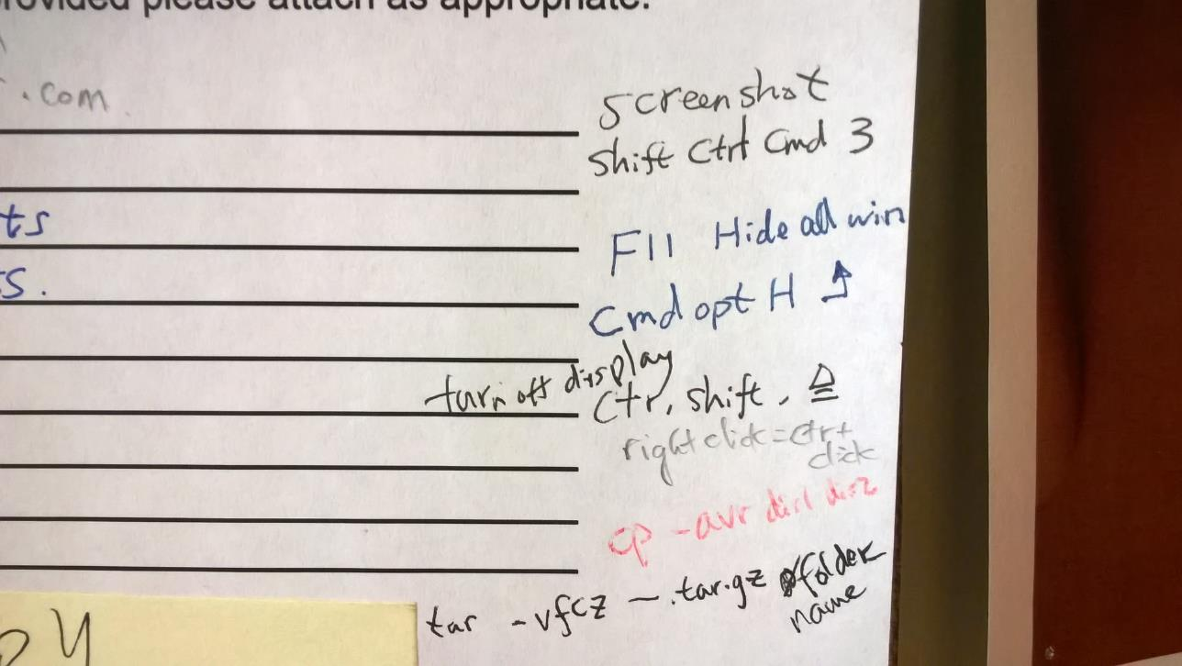
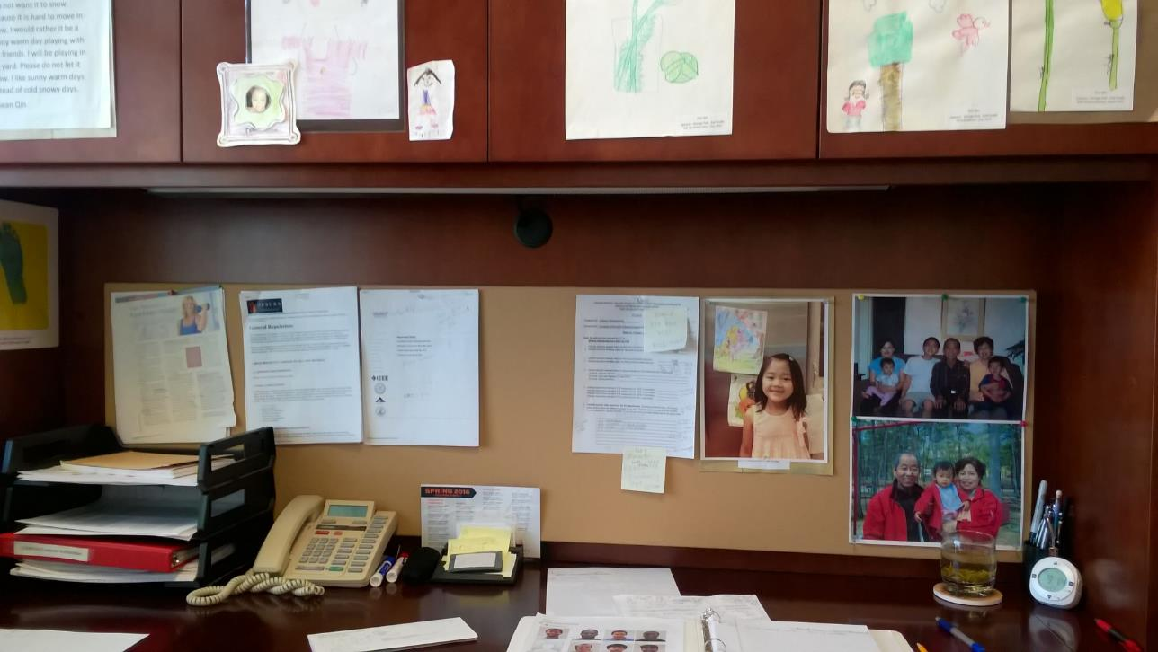
How to Learn Commands
Cheating sheet
Frequent Use and Naturally memorize
Notes:
Teach students how to take notes.

Slide 15
How do we get the file off the computer and into Canvas?
The sftp command
mount a flash drive
Add a desktop environment

Slide 16
The sftp Command
You may use the sftp command to transfer files from your lab PC into the engineering’s tux machines. For example, you can start using this command on your lab PC's terminal as, assuming your engineering user name is xzq0001:
#sftp xzq0001@scp.eng.auburn.edu
Then, you can easily access your transferred files on your engineering machines. For more information on how to use sftp, please refer to the “Transferring Files with SFTP” section of this webpage:
https://www.digitalocean.com/community/tutorials/how-to-use-sftp-to-securely-transfer-files-with-a-remote-server

Slide 17
mount a Flash Drive
You mount a flash drive, to which you copy the tarred archive. Then, you need unmount the flash drive. You then plug the flash drive into a laptop or another computer to upload the report to Canvas. Please refer to the following instructions on how to use mount and unmount commands in Linux:
http://www.thegeekstuff.com/2013/01/mount-umount-examples/

Slide 18
Add a Desktop Environment
You can add a desktop environment on your minimal CentOS. You may use the following command to add Gnome/GUI to your minimal CentOS install:
yum groupinstall basic-desktop desktop-platform x11 fonts
A long version is given below:
yum groupinstall "Desktop" "Desktop Platform" "X Window System" "Fonts"

Slide 19
What’s the report format?
Option 1: A single File
“project1.pdf”
A Tarball for Multiple Script Files
%tar vfcz project1.tgz /comp7500/project1

